Slide 1
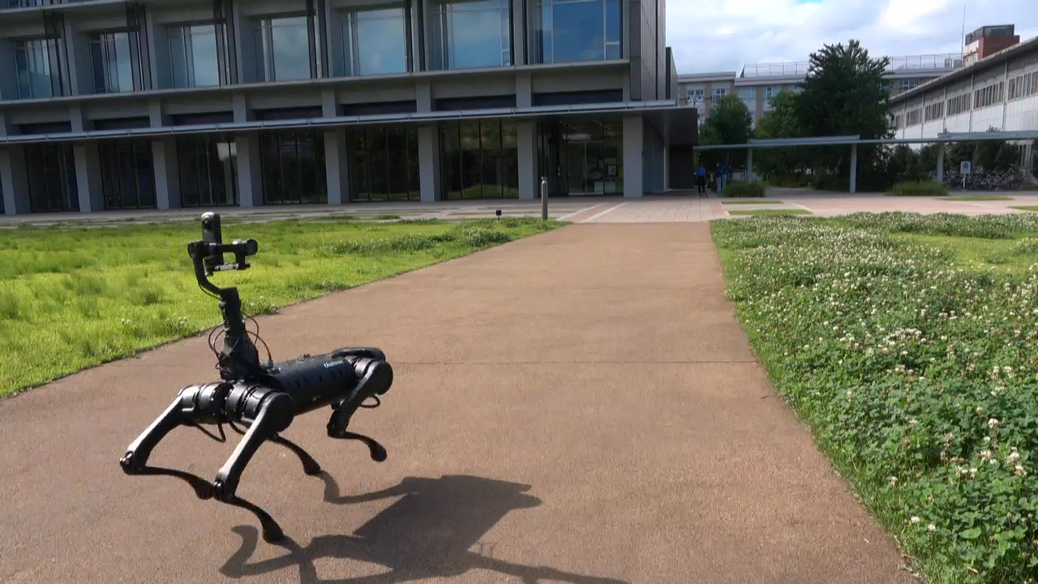
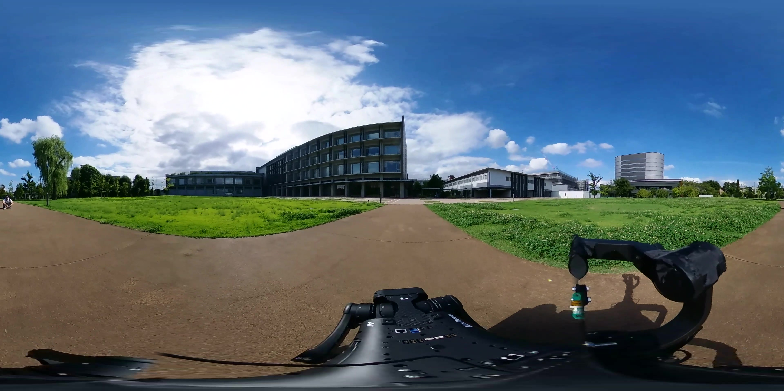
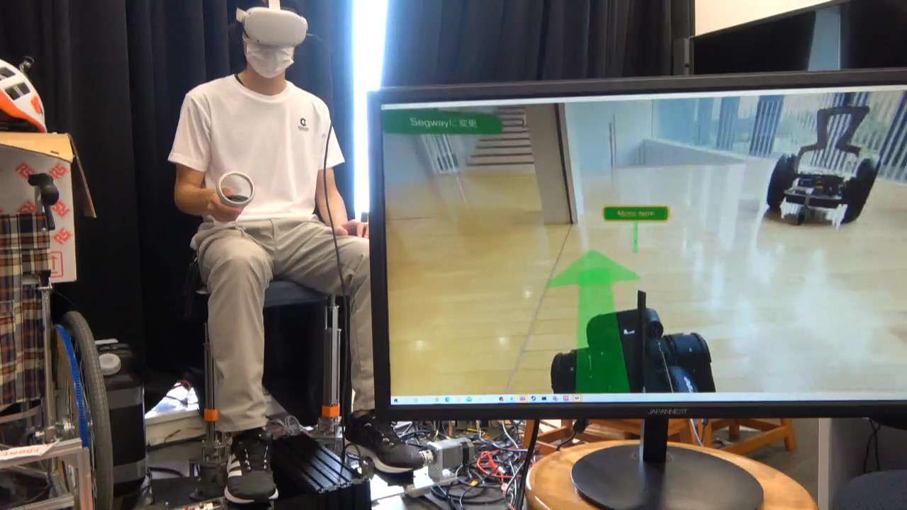
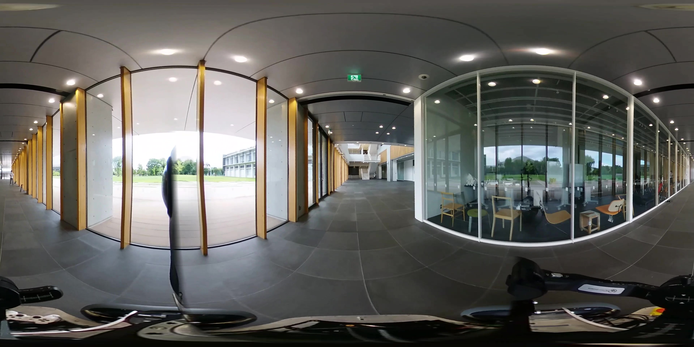
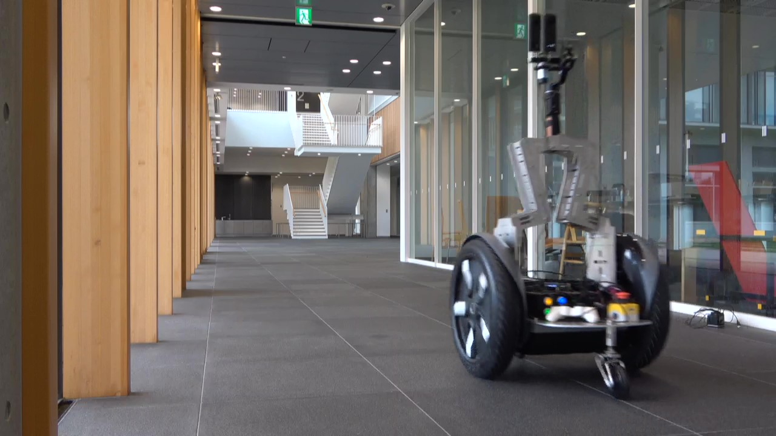
Video stream
Quadruped telepresence robot
Moving command
Speed
Video stream
Wheeled telepresence
robot
Moving command
Body motion display
Moving status of a robot
Speed

Slide 2
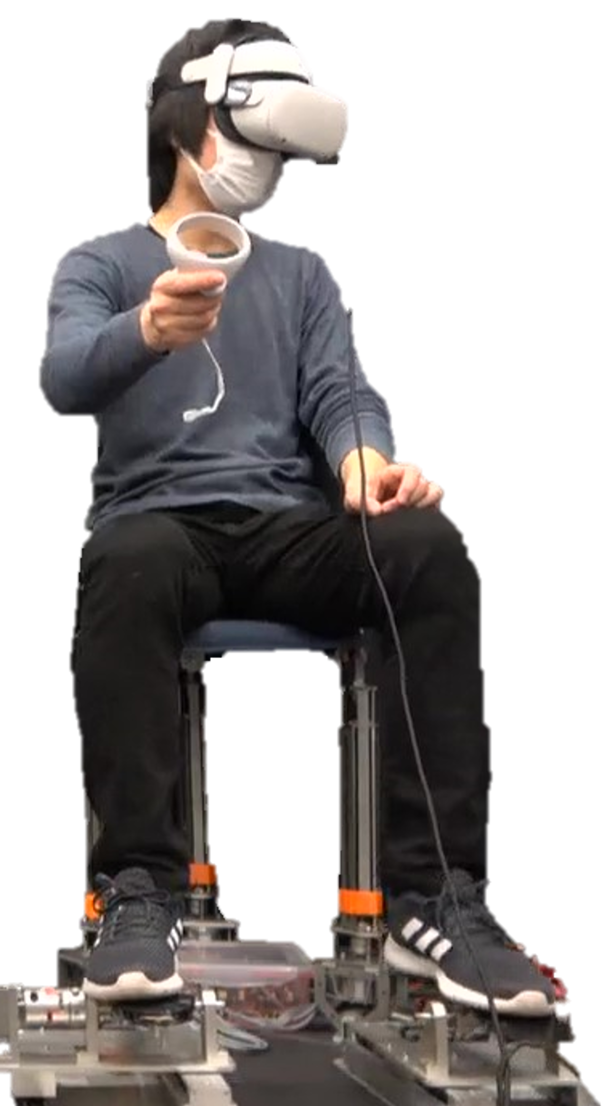

Slide 4





Real space
Remote space
Local space
Space $α$
HMD
Divided into two avatars
Avatar $α$
Space $β$
Operator
Avatar $β$

Slide 5
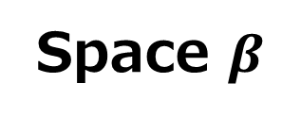
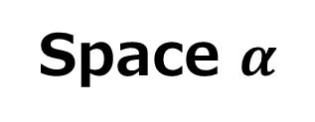


Real space
Local space
Remote space
Integrated space
(Not real)
Space $α$
Fusing two spaces
HMD
Avatar $α$
Space $β$
Operator
Avatar $β$

Slide 6






Real environment
Local space
HMD
Operator
Remote space $α$
Remote space $β$
Avatar $α$
Avatar $β$

Slide 7




Real environment
Local space
Remote space $β$
Remote space $α$
HMD
Operator
Avatar $α$
Avatar $β$

Slide 8


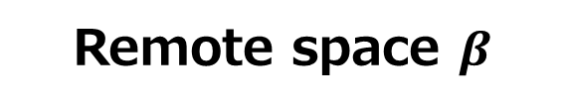

Real environment
Cyberspace
Local space
HMD
Operator
Avatar
Remote space $α$
Remote space $β$

Slide 9
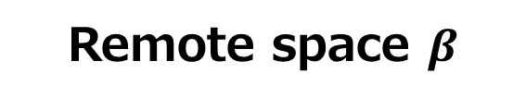





Real environment
Real environment
Cyberspace
Local space
Local space
HMD
HMD
Operator
Operator
Avatar
Remote space $α$
Remote space $α$
Remote space $β$
Remote space $β$
Avatar $α$
Avatar $β$

Slide 10


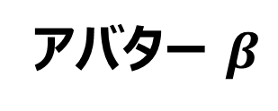
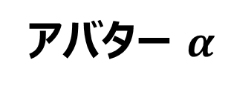
ローカル空間
HMD
操作者
遠隔空間 $α$
遠隔空間 $β$
アバター $α$
アバター $β$

Slide 11


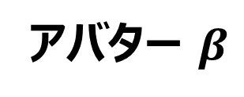
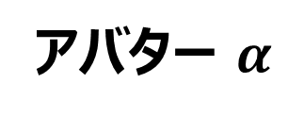
遠隔空間 $α$
ローカル空間
アバター $α$
HMD
遠隔空間 $β$
操作者
アバター $β$

Slide 12


サイバー空間
遠隔空間 $α$
ローカル空間
HMD
アバター
遠隔空間 $β$
操作者

Slide 13


Cyberspace
Real environment
Local space
Avatar
Remote Space $α$
Remote space $β$
HMD
Operator

Slide 14
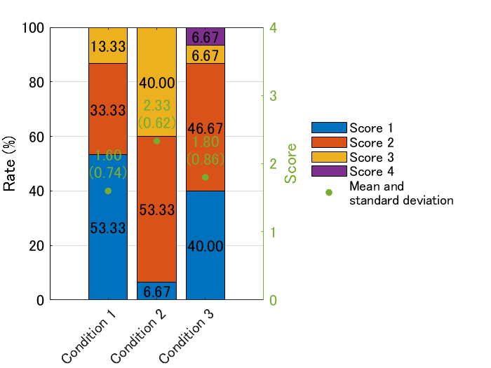
HMD

Slide 15
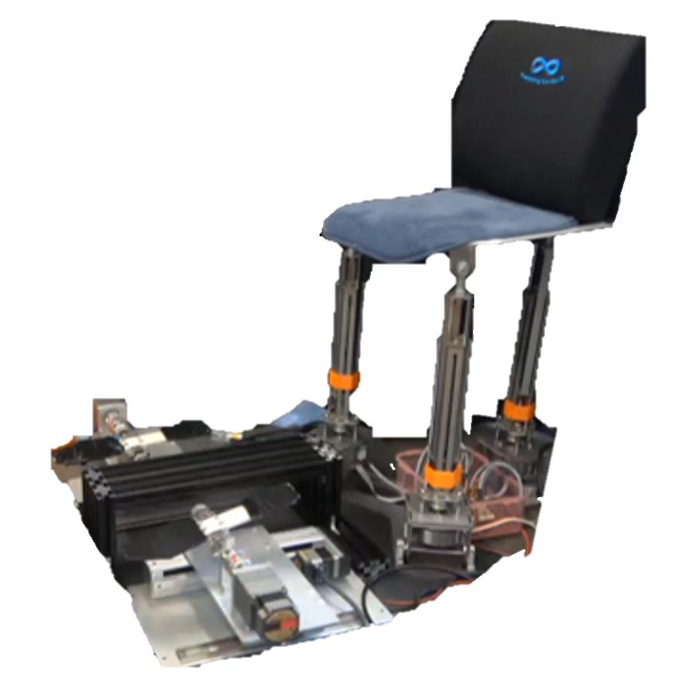
Roll
Pitch
Lift

Slide 16
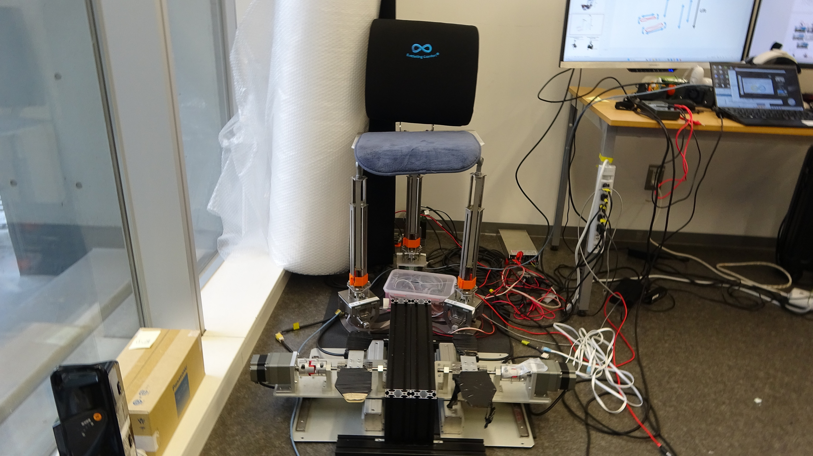



Slide 17
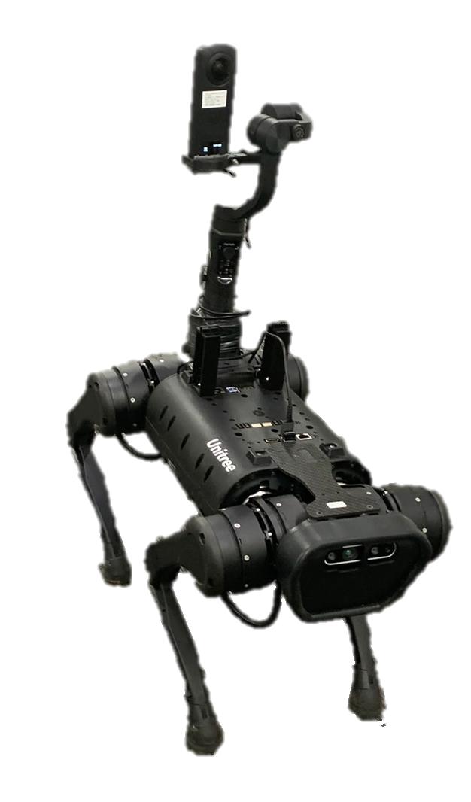
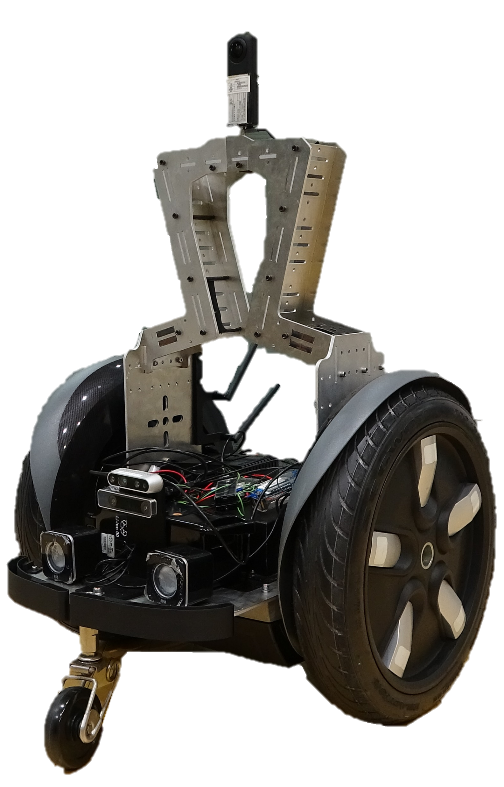
Quadruped telepresence robot
(Unitree A1)
Wheeled telepresence robot
(Segway RMP)
360°Camera (Ricoh TETA Z1)
360°Camera (Ricoh THETA Z1)
Sensor PC (Jetson)
Sensor PC (Jetson)

Slide 18
360°Camera (Ricoh THETA Z1)
360°Camera (Ricoh TETA Z1)

Slide 19
Roll
Pitch
360°Camera (Ricoh THETA Z1)
Sensor PC (Jetson)
Lift
Depth and RGB camera (D435i)
Quadruped telepresence robot
(Unitree A1)
Wheeled telepresence robot
(Segway RMP)

Slide 20

Walking sensation display
Tester
Wheeled telepresence robot
Quadruped telepresence robot
HMD
Separated by physical distance

Slide 21
Remote space 1
Body motion display
Wheeled robot
Local space
Tester
Remote space 2
Quadruped robot
HMD

Slide 22
Body motion display
Local space
Remote space 1
Remote space 2
User
Wheeled robot
Quadruped robot
HMD

Slide 23
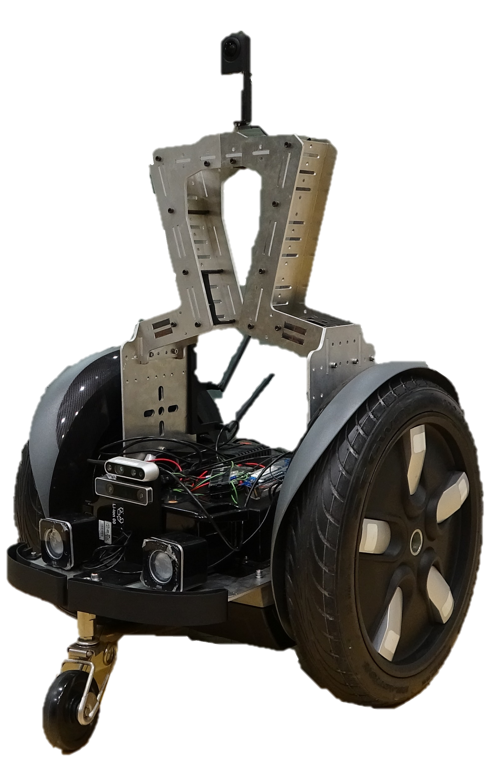
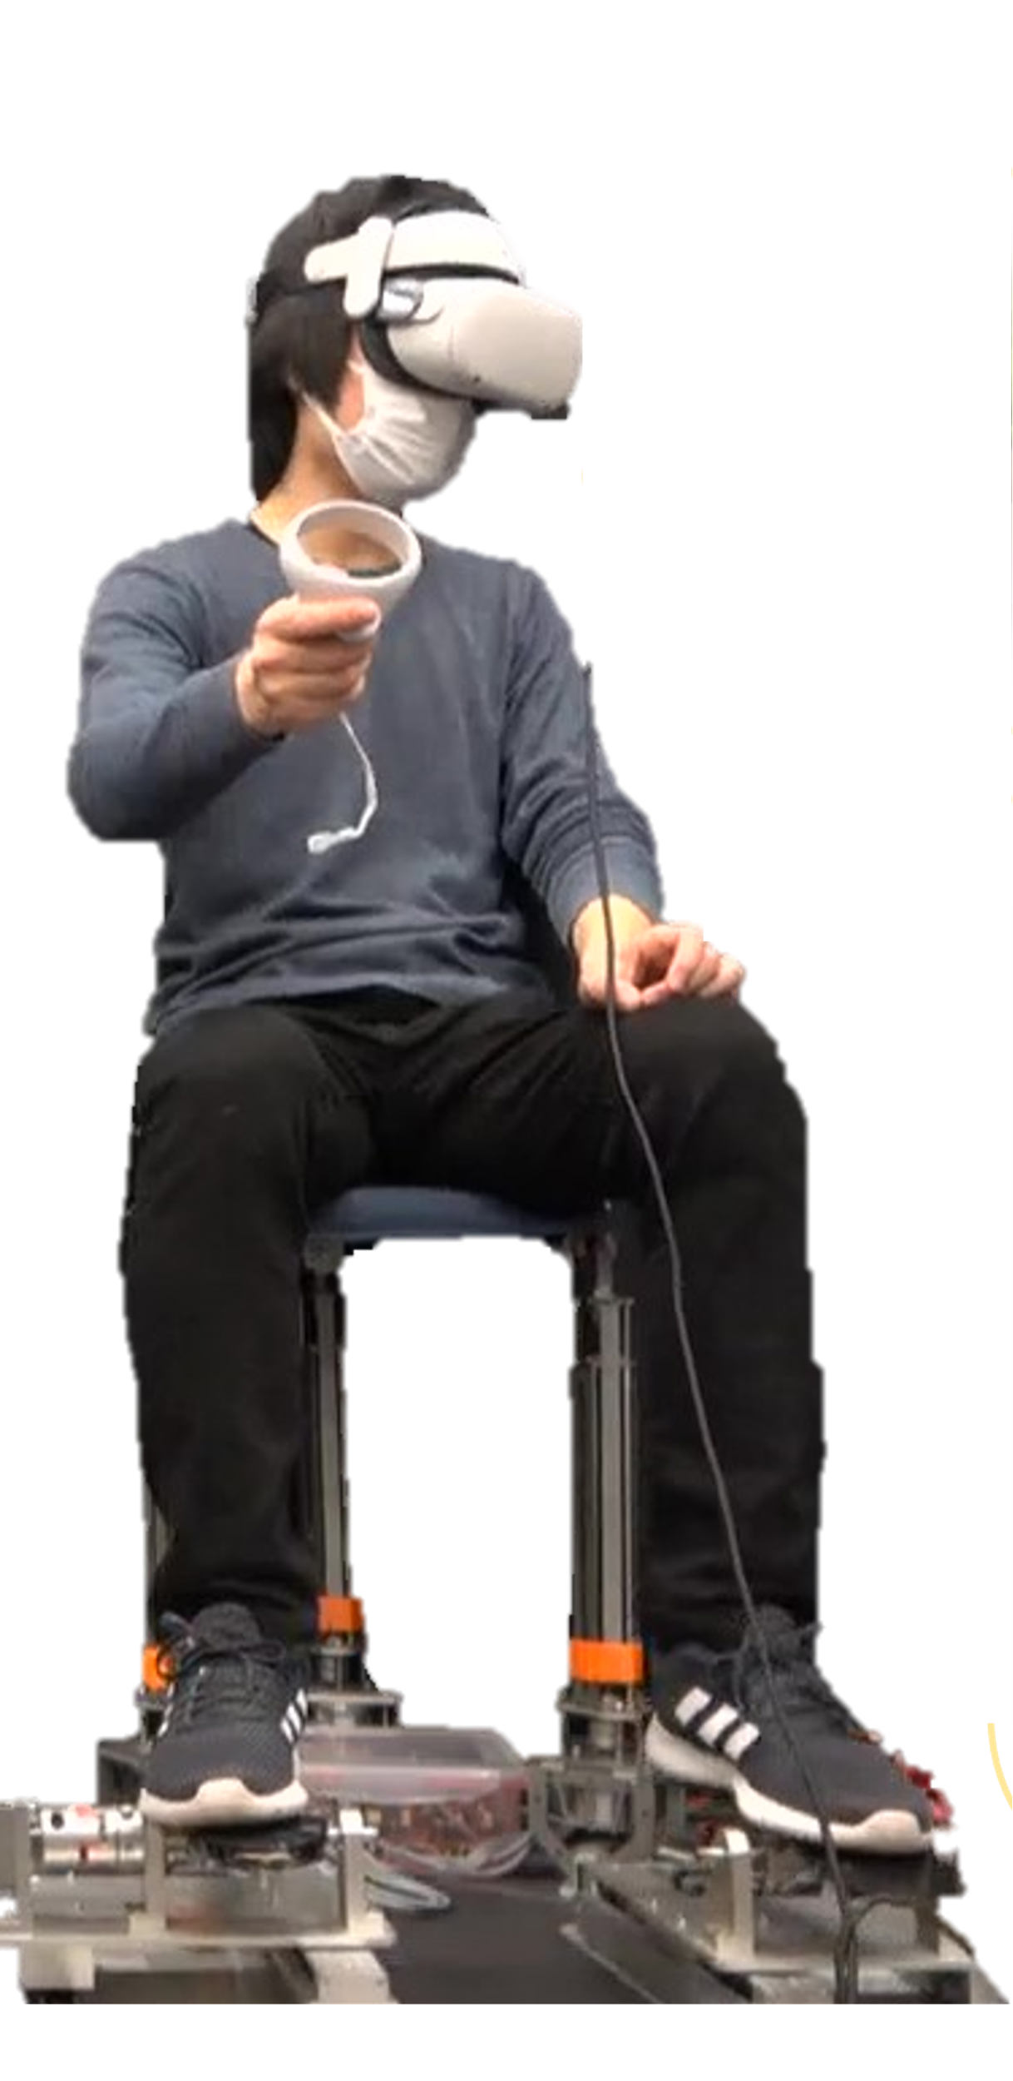

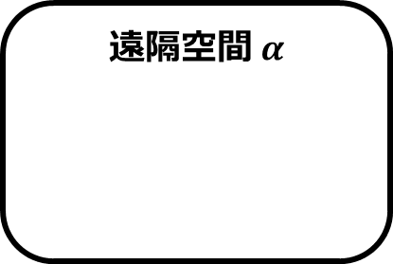

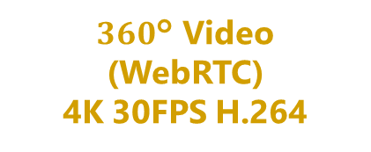
SFU Server
(Sora, Ubuntu)
$360$° Video
(WebRTC)
4K 30FPS H.264
ローカル空間
メディアチャネル
遠隔空間 $α$
データチャネル
映像提示手法
全方位カメラ
操作コマンド
遠隔空間 $β$
全方位カメラ
歩行フィードバック

Slide 24
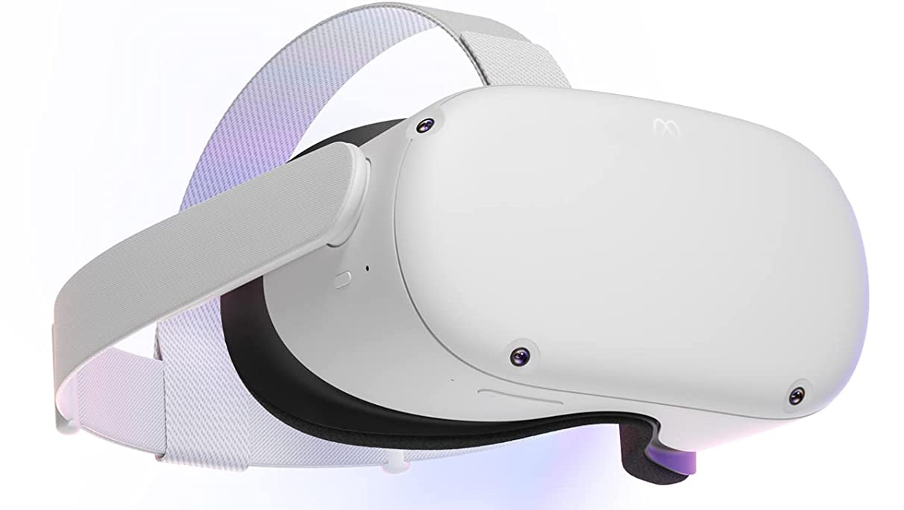



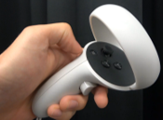
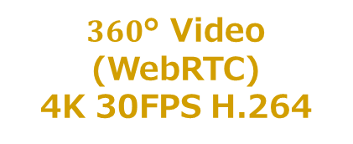
Video
Meta Quest2
Cloud SFU Server (Sora, Ubuntu, Azure)
Quadruped robot
Meta Browser
360°4K Camera
(THETA Z1)
WebRTC SDK
(Sora JavaScript SDK)
Video
Sensor PC
(Jetson NX)
Stick input
(WebRTC)
Real time 3D engine
using a JavaScript library
Leg Controller Board
Speed
Robot Speed
(WebRTC)
Movement command
$360$° Video
(WebRTC)
4K 30FPS H.264
Walking Display
Wheeled robot
360°4K Camera
(THETA Z1)
Web XR input device
Unity Sora SDK
(WebRTC SDK)
Movement status
Sensor PC
(Jetson NX)
Speed
Controller
EPOS4, ESP32
Body motion display
Wheel Controller Board

Slide 25
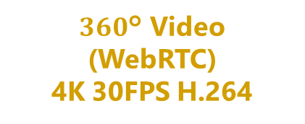
Video
Meta Quest2
Cloud SFU Server (Sora, Ubuntu, Azure)
Quadruped robot
Meta Browser
360°4K Camera
(THETA Z1)
WebRTC SDK
(Sora JavaScript SDK)
Video
Sensor PC
(Jetson NX)
Stick input
(WebRTC)
Real time 3D engine
using a JavaScript library
Leg Controller Board
Speed
Robot Speed
(WebRTC)
Movement command
$360$° Video
(WebRTC)
4K 30FPS H.264
Walking Display
Wheeled robot
360°4K Camera
(THETA Z1)
Web XR input device
Unity Sora SDK
(WebRTC SDK)
Movement status
Sensor PC
(Jetson NX)
Speed
Controller
EPOS4, ESP32
Body motion display
Wheel Controller Board

Slide 26

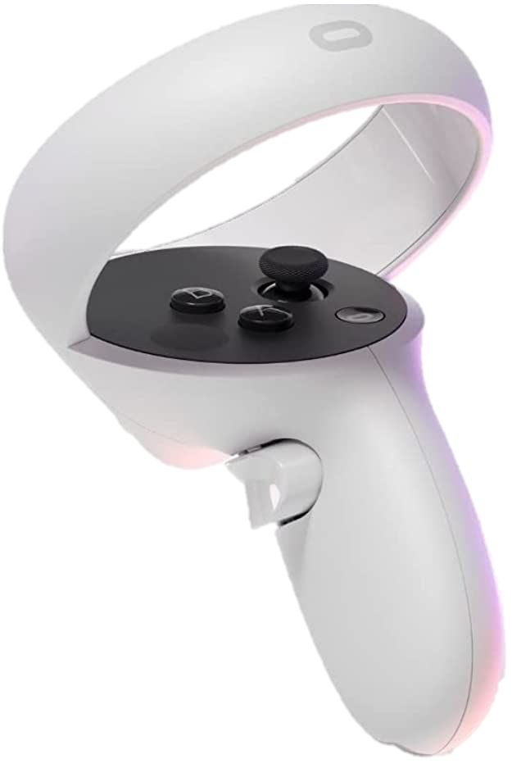
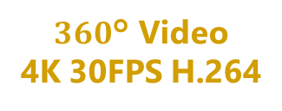
Meta Quest2
$360$° Video
4K 30FPS H.264
Wheeled robot
Meta Browser
360°4K Camera
(THETA Z1)
Cloud SFU Server (Sora, Ubuntu, Azure)
WebRTC SDK
(Sora JavaScript SDK)
Sensor PC
(Jetson NX)
Real time 3D engine
using a JavaScript library
Status of robots
Wheel Controller Board
Walking Display
Quadruped robot
360°4K Camera
(THETA Z1)
Unity Sora SDK
(WebRTC SDK)
Web XR input device
Sensor PC
(Jetson NX)
Controller
EPOS4, ESP32
Angle of joystick
Leg Controller Board

Slide 27
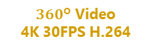
Meta Quest2
Web XR input device
Angle of joystick
Meta Browser
Walking Display
Controller
EPOS4, ESP32
Real time 3D engine
using a JavaScript library
PC
WebRTC SDK
(Sora Unity SDK)
WebRTC SDK
(Sora JavaScript SDK)
Cloud SFU Server (Sora, Ubuntu, Azure)
Status of robots
$360$° Video
4K 30FPS H.264
Quadruped robot
Wheeled robot
360°4K Camera
(THETA Z1)
360°4K Camera
(THETA Z1)
Sensor PC
(Jetson NX)
Sensor PC
(Jetson NX)
Leg Controller Board
Wheel Controller Board

Slide 28
Video
Video
Speed
Movement command
Movement status
Speed
Body motion display

Slide 29
Video
Video
Speed
Movement command
Movement status
Speed
Body motion display

Slide 30
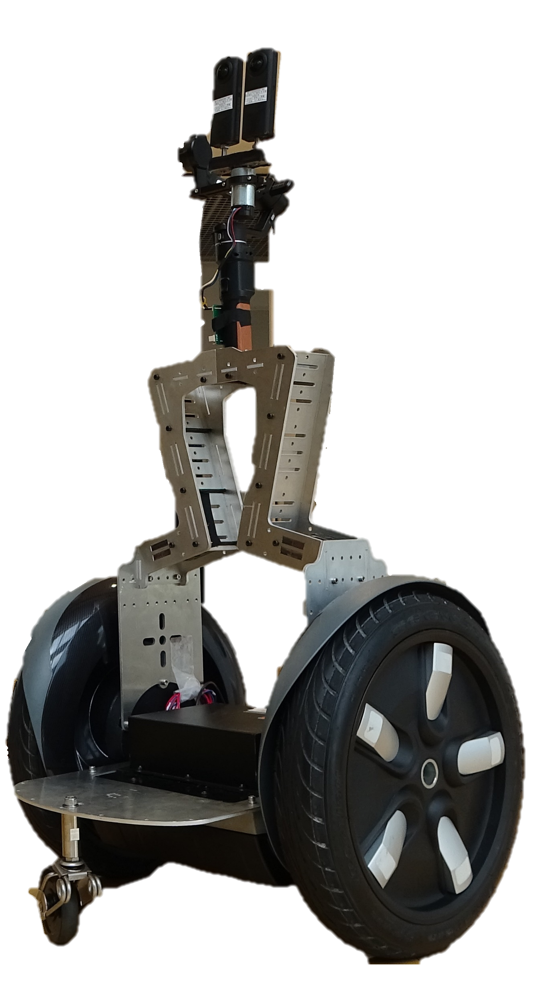
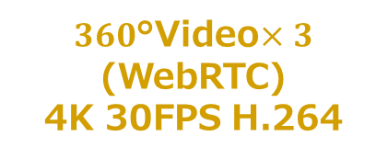
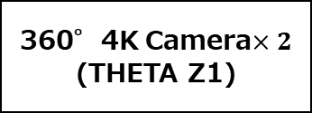
Avatar Robot 1
Sensor PC
(Jetson NX)
360°4K Camera
(THETA Z1)
Meta Quest2
Meta Browser
Cloud SFU Server (Sora, Ubuntu, Azure)
$360$°Video$×3$
(WebRTC)
4K 30FPS H.264
WebRTC SDK
(Sora JavaScript SDK)
Real time 3D engine
using a JavaScript library
Avatar Robot 2
Sensor PC
(Jetson NX)
360°4K Camera$×2$
(THETA Z1)

Slide 31
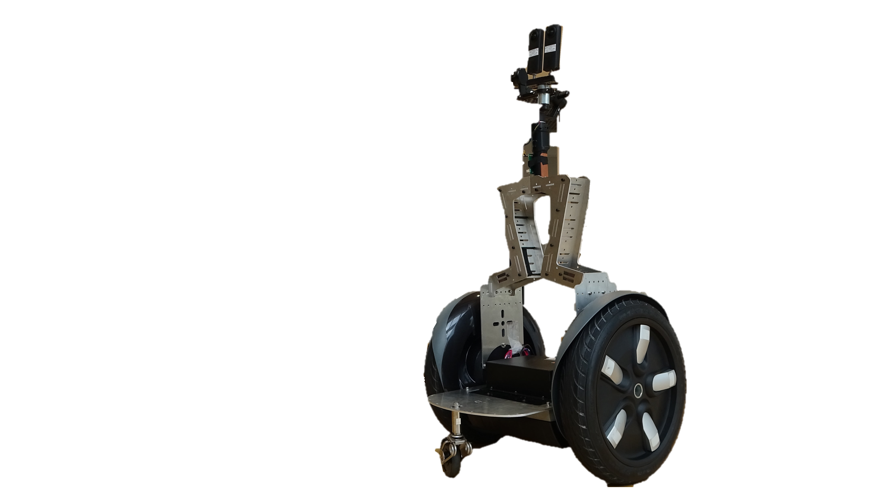
Avatar Robot 1
Sensor PC
(Jetson NX)
Walk Control PC
(Jetson NX)
Meta Quest2
Stick input
(WebRTC)
Cloud SFU Server (Sora, Ubuntu, Azure)
Leg Controller Board
Meta Browser
WebRTC SDK
(Sora JavaScript SDK)
Stick input
(WebRTC)
Real time 3D engine
using a JavaScript library
Avatar Robot 2
Sensor PC
(Jetson NX)
Wheel Controller Board
Web XR input device
(Quest2 Controller)

Slide 32
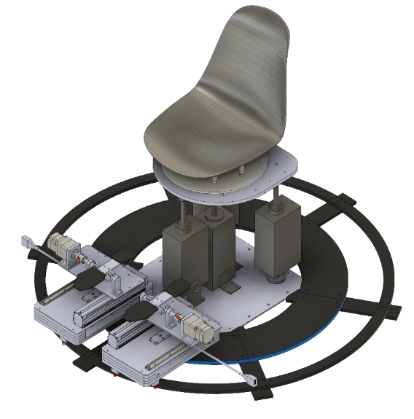
Avatar Robot 1
Cloud SFU Server (Sora, Ubuntu, Azure)
Robot Speed
(WebRTC)
Sensor PC
(Jetson NX)
Walk Control PC
(Jetson NX)
Walking Display
Leg Controller Board
Unity Sora SDK
(WebRTC SDK)
Avatar Robot 2
Controller
EPOS4
Sensor PC
(Jetson NX)
Wheel Controller Board
32

Slide 33
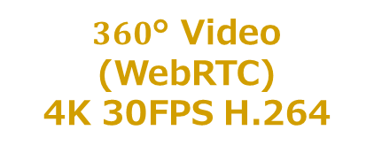
Meta Quest2
Cloud SFU Server (Sora, Ubuntu, Azure)
Quadruped robot
Meta Browser
360°4K Camera
(THETA Z1)
WebRTC SDK
(Sora JavaScript SDK)
Sensor PC
(Jetson NX)
Stick input
(WebRTC)
Real time 3D engine
using a JavaScript library
Robot Speed
(WebRTC)
Leg Controller Board
$360$° Video
(WebRTC)
4K 30FPS H.264
Walking Display
Wheeled robot
360°4K Camera
(THETA Z1)
Unity Sora SDK
(WebRTC SDK)
Web XR input device
Sensor PC
(Jetson NX)
Controller
EPOS4, ESP32
Wheel Controller Board

Slide 34

Meta Quest2
Cloud SFU Server (Sora, Ubuntu, Azure)
Quadruped robot
Meta Browser
360°4K Camera
(THETA Z1)
WebRTC SDK
(Sora JavaScript SDK)
Sensor PC
(Jetson NX)
Stick input
(WebRTC)
Real time 3D engine
using a JavaScript library
Robot Speed
(WebRTC)
Leg Controller Board
$360$° Video
(WebRTC)
4K 30FPS H.264
Walking Display
Wheeled robot
360°4K Camera
(THETA Z1)
Unity Sora SDK
(WebRTC SDK)
Web XR input device
Sensor PC
(Jetson NX)
Controller
EPOS4, ESP32
Wheel Controller Board

Slide 35
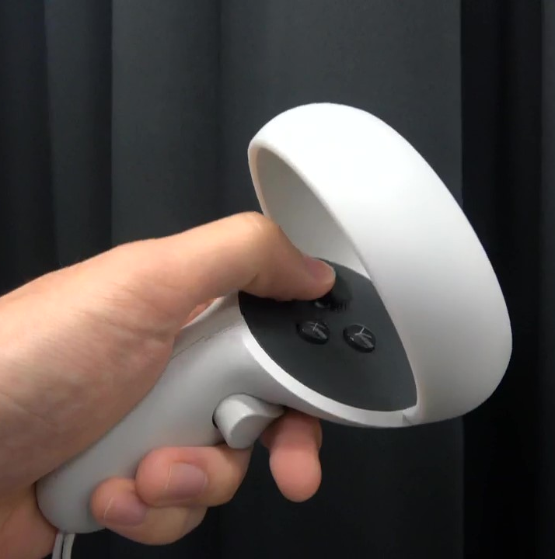
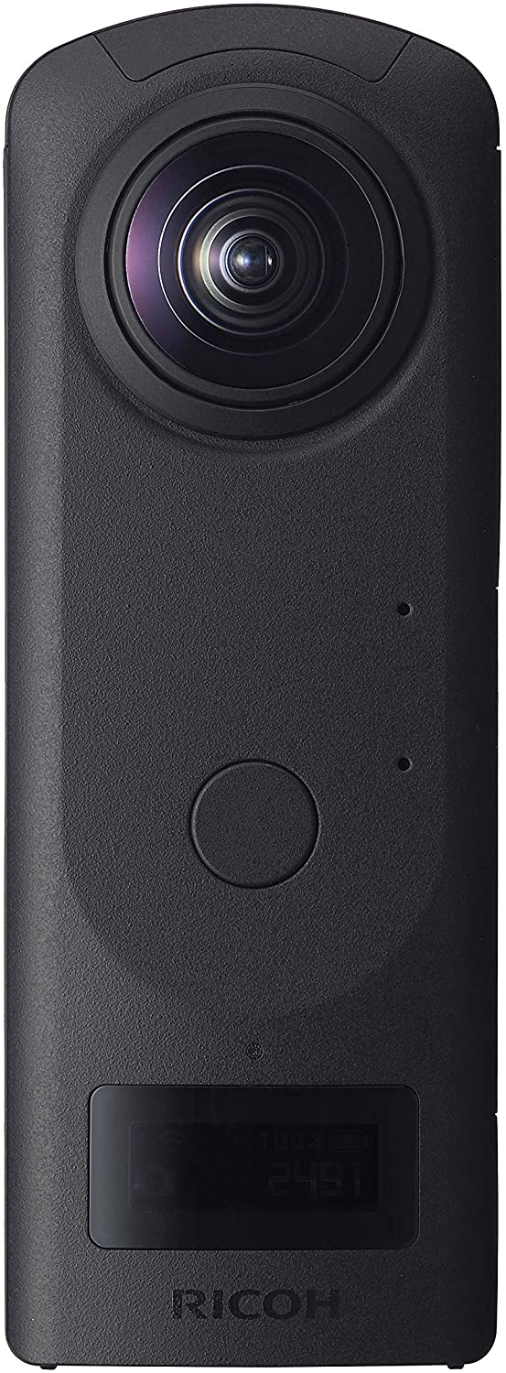
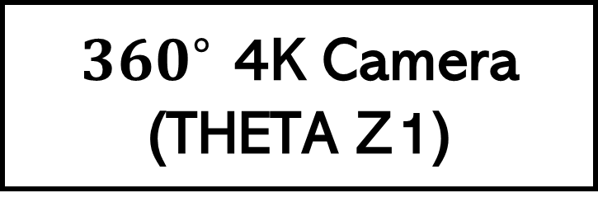
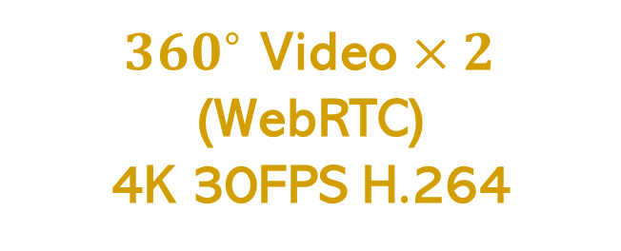
Meta Quest2
Meta Browser
Real time 3D engine using a JavaScript library
Web XR input device
WebRTC SDK
(Sora JavaScript SDK)
Motion Display
Stick input
(WebRTC)
360°Video
(WebRTC)
4K 30FPS H.264
Unity Sora SDK
(WebRTC SDK)
Robot Speed
(WebRTC)
Motion Controller
(EPOS4)
Cloud SFU Server
(Sora, Ubuntu, Azure)
${360}^{∘}$ Video $×2$
(WebRTC)
4K 30FPS H.264
Robot 1
Robot 2
$360^{∘}$ 4K Camera
(THETA Z1)
360°4K Camera
(THETA Z1)
Sensor PC
(Jetson NX)
Sensor PC
(Jetson NX)
Wheel Controller Board
Leg Controller Board

Slide 36
HMD
HMD
HMD

Slide 37
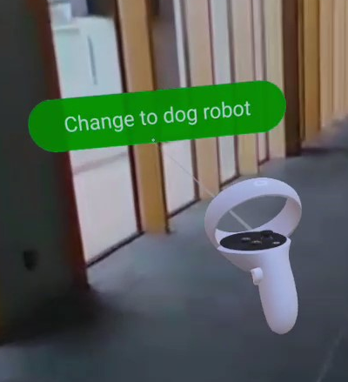
(a)
(c)
(b)
(d)
(e)

Slide 38
(c)
(a)
(d)
(b)
(e)

Slide 39
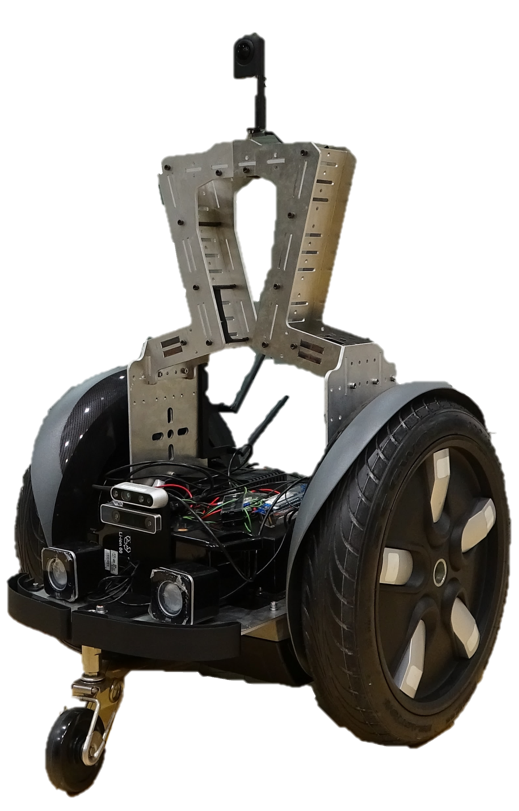
透明度30%
合成
透明度70%
透明度70%
合成
透明度30%

Slide 40
透明度30%
合成
透明度70%
透明度70%
合成
透明度30%

Slide 41
操作対象
操作対象
透明度30%
透明度70%
透明度70%
透明度30%
合成
合成

Slide 42
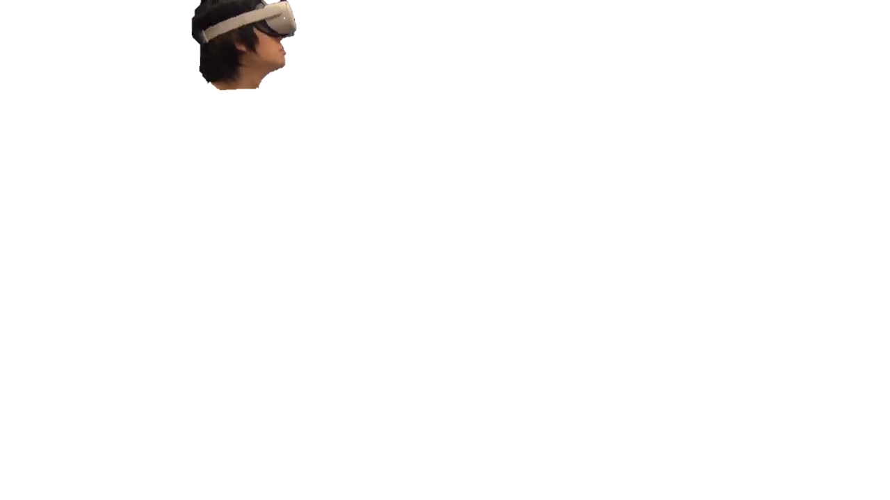
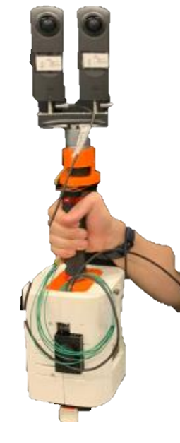
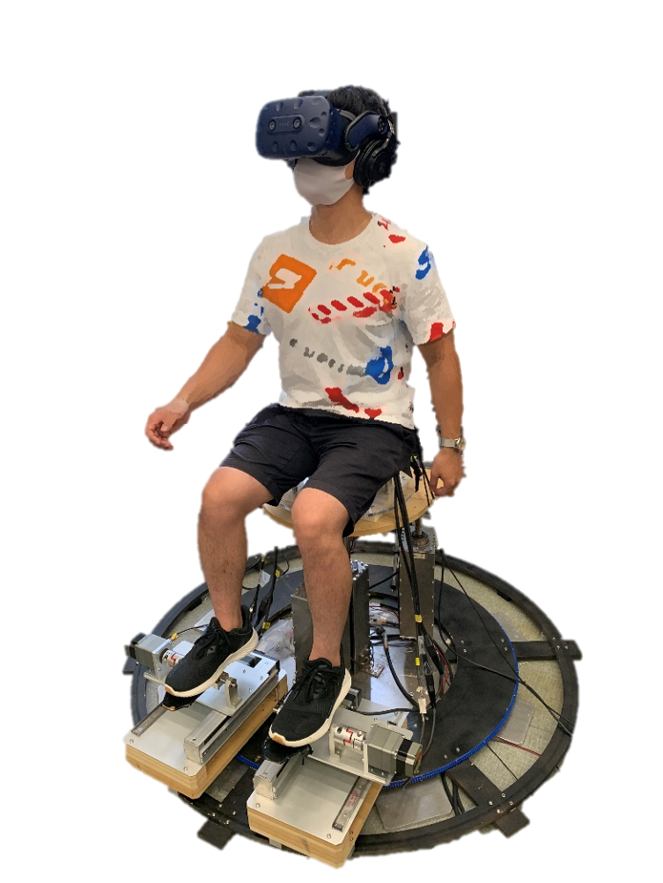


$$⋯$$
全天周
両眼映像
観察者（視点共有）
SFU Server
操作者（立体視）
手持ち TwinCam
$$⋯$$
全天周
両眼映像
観察者（視点共有）
操作者（立体視）
前庭感覚
移動情報
ロボット・Twincam
歩行感覚ディスプレイ

Slide 43

$$⋯$$
全天周
両眼映像
観察者（視点共有）
SFU Server
操作者（立体視）
手持ち TwinCam
$$⋯$$
全天周
両眼映像
観察者（視点共有）
操作者（立体視）
前庭感覚
移動情報
ロボット・Twincam
歩行感覚ディスプレイ

Slide 45
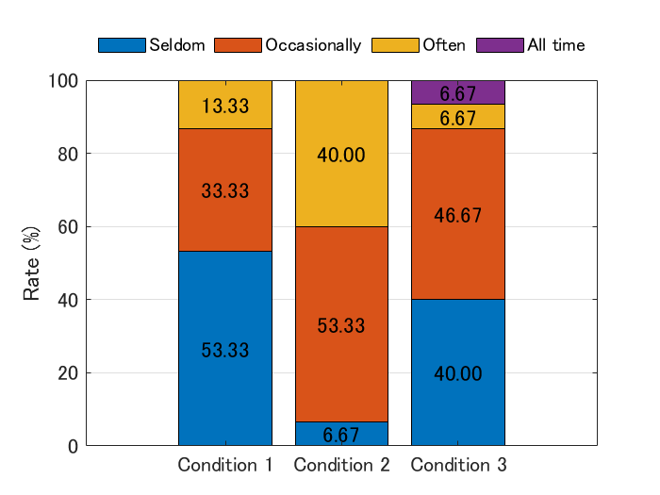
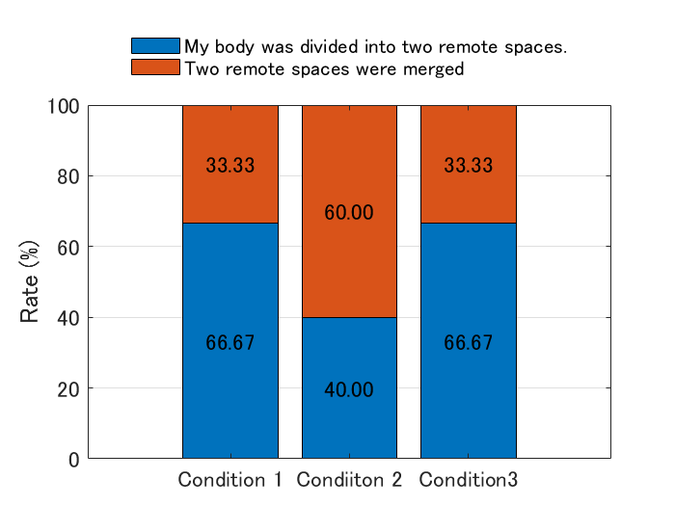
How often did you feel as if you were simultaneously present in two remote spaces?

Slide 46
